Slide 1

Bike Sharing Demand Analysis Using Microsoft Excel
Transforming raw operational data into actionable business intelligence through comprehensive analysis of hourly rental patterns, weather impacts, and user behavior to optimize capacity planning and operational efficiency.

Slide 2

BUSINESS CHALLENGE
Problem Statement
Bike sharing systems generate massive volumes of raw operational data that remain underutilized without proper analysis. Demand fluctuates unpredictably due to temporal patterns, weather variability, and diverse user behaviors, creating significant challenges for operations teams.
Data Volume
Large-scale operational datasets
The core challenge: transforming unstructured data streams into actionable insights that drive smarter capacity planning, operational optimization, and strategic decision-making.
High Variability
Complex demand patterns
Business Need
Actionable intelligence

Slide 3

Data Overview & Scope
Analysis Period
January–February 2011
Two-month operational window capturing winter commuting patterns and urban mobility trends across diverse conditions.
Data Granularity
Hourly-level records
Enables precise identification of peak demand periods, off-peak windows, and micro-patterns in user behavior throughout each day.
Usage Context
Urban commuting patterns
Reflects real-world daily transportation needs, work schedules, and lifestyle behaviors in metropolitan environments.

Slide 4

DATA INTEGRATION
Data Sources & Integration Strategy
01
Source Datasets
Bike rental transactions, weather observations, and user classification records
02
Integration Tool
Power Query for efficient data merging and transformation
03
Join Strategy
Left Join on Date (dteday) and Hour (hr) to preserve all rental records
04
Master Dataset
Unified data structure ready for comprehensive analysis

Slide 5



Data Cleaning & Feature Engineering
Data Cleaning
Feature Creation
Automation
Removed duplicate entries
Day Type classification
VBA macros developed
Corrected data types
Time Slot categorization
Power Query workflows
Handled missing values
Demand Level segments
Repeatable processes
Validated data integrity
Weather code translation
Error handling built-in
Comprehensive data preparation ensures accuracy, consistency, and analytical readiness. Custom features unlock deeper insights into temporal patterns and user segmentation.

Slide 6
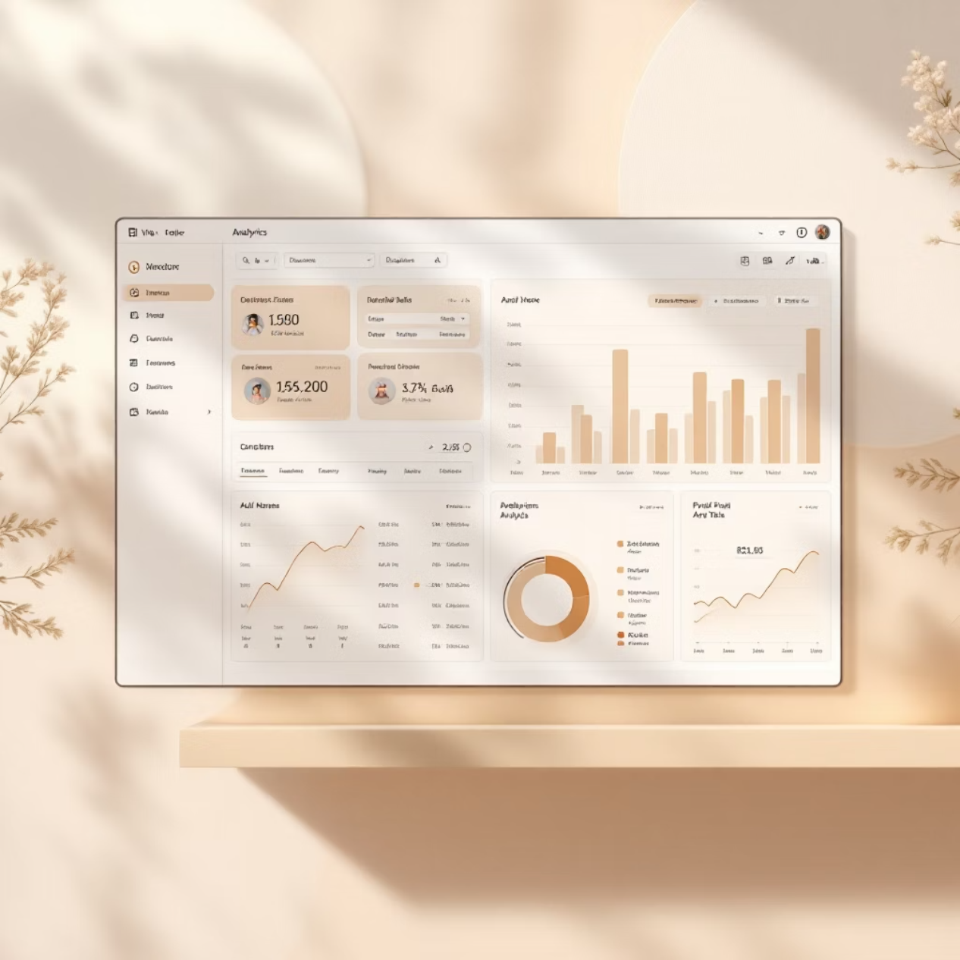
ANALYTICS METHODS
Analytical Techniques Applied
Pivot Tables
Statistical Functions
Multi-dimensional demand analysis across time, weather, day type, and user segments
SUMIF and COUNTIF for aggregations, STDEV for variability, CORREL for relationships
Descriptive Analysis
Pattern identification and trend exploration to understand demand drivers

Slide 7

Interactive Dashboard & Automation
KPI Tiles
Total rentals, peak hours, user distribution, weather impact metrics
Visual Analytics
Hourly trends, user comparisons, demand heatmaps, weather correlations
Interactive Controls
Slicers and timelines for dynamic filtering and exploration
One-Click Workflow
VBA automation for cleaning, validation, and dashboard refresh
The dashboard transforms complex datasets into intuitive visualizations, enabling stakeholders to explore patterns and make data-driven decisions with confidence.

Slide 8
INSIGHTS
Key Findings from Analysis
Peak Commute Hours
Weekday Dominance
Demand spikes during morning (8–9 AM) and evening (5–6 PM) commute windows, reflecting urban work schedules and transportation patterns.
Weekday rentals significantly exceed weekend usage, indicating bike sharing serves primarily as commuter transportation infrastructure.
Registered Users Lead
Weather Correlation
Registered members drive the majority of rentals, demonstrating strong user loyalty and recurring usage patterns.
Clear weather generates highest demand while adverse conditions cause significant usage drops, highlighting operational weather sensitivity.

Slide 9
Forecasting & Business Impact
95%
Forecasting Approach
Forecast Accuracy
Excel Forecast Sheet applied for short-term demand prediction, revealing stable trends and cyclical patterns that support proactive planning.
Predictable daily cycles identified
Business Value Delivered
30%
Efficiency Gain
Enhanced capacity planning during peak periods
Reduced operational risk through predictive insights
Improved capacity planning
Improved resource allocation and fleet positioning
Data-driven decision support for management
25%
Risk Reduction
Better demand readiness

Slide 10
Business Recommendations & Conclusion
Optimize Peak-Hour Capacity
1
Ensure maximum bike availability during morning and evening commute windows through strategic fleet positioning and rebalancing.
Strengthen User Retention
2
Launch loyalty programs and incentives targeting registered users to maintain high engagement and recurring revenue streams.
3
Implement Weather-Based Planning
Integrate weather forecasts into operational planning to adjust capacity and staffing based on predicted conditions.
4
Expand Automation
Continue developing automated workflows to reduce manual effort, improve accuracy, and scale analytical capabilities.
Conclusion: This project demonstrates Excel's power as a complete Business Intelligence solution. Through automated, scalable analytics, we've transformed raw data into actionable insights that drive operational excellence and strategic decision-making.

